Slide 1
EC 485: Time Series Analysis in a Nut Shell

Slide 2
Data Preparation:
Plot data and examine for stationarity
Examine ACF for stationarity
If not stationary, take first differences
If variance appears non-constant,
take logarithm before first differencing
Examine the ACF after these transformations
to determine if the series is now stationary
Model Identification and Estimation:
Examine the ACF and PACF’s of your
(now) stationary series to get some ideas
about what ARIMA(p,d,q) models to estimate.
2) Estimate these models
3) Examine the parameter estimates, the AIC statistic
and test of white noise for the residuals.
Forecasting:
Use the best model to construct forecasts
Graph your forecasts against actual values
Calculate the Mean Squared Error for the forecasts

Slide 3
Data Preparation:
Plot data and examine. Do a visula inspection to determine if your series is non-stationary.
2) Examine Autocorrelation Function (ACF) for stationarity. The ACF for a non-stationary series will show large autocorrelations that diminish only very slowly at large lags. (At this stage you can ignore the partial autocorrelations and you can always ignore what SAS calls the inverse autocorrelations.
3) If not stationary, take first differences. SAS will do this automatically in the IDENTIFY VAR=y(1) statement where the variable to be “identified” is y and the 1 refers to first-differencing.
If variance appears non-constant, take logarithm before first differencing. You would take the log before the IDENTIFY
statement:
ly = log(y);
PROC ARIMA;
IDENTIFY VAR=ly(1);
Examine the ACF after these transformations to determine if the series is now stationary

Slide 4
In this presentation, a variable measuring the capacity utilization for the U.S. economy is modeled. The data are monthly from 1967:1 – 2004:03.
It will be used as an example of how to carry out the three steps outlined on the previous slide.
We will remove the last 6 observations 2003:10 – 2004:03 so that we can construct out-of-sample forecasts and compare our models’ ability to forecast.

Slide 5
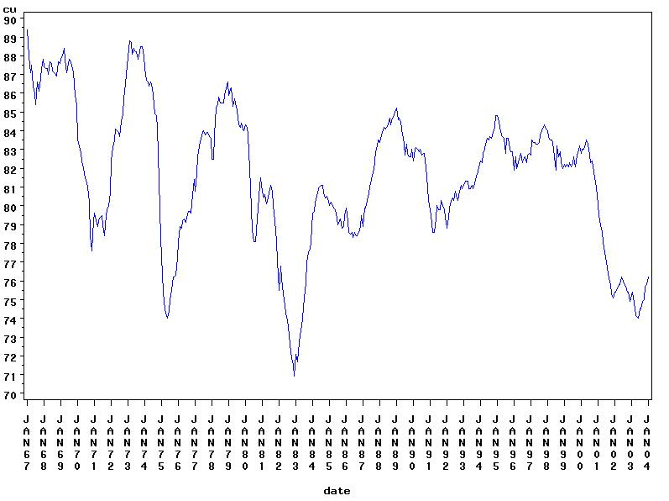
Capacity Utilization 1967:1 – 2004:03 (in levels)
This plot of the raw data indicates non-stationarity, although there
does not appear to be a strong trend.

Slide 6
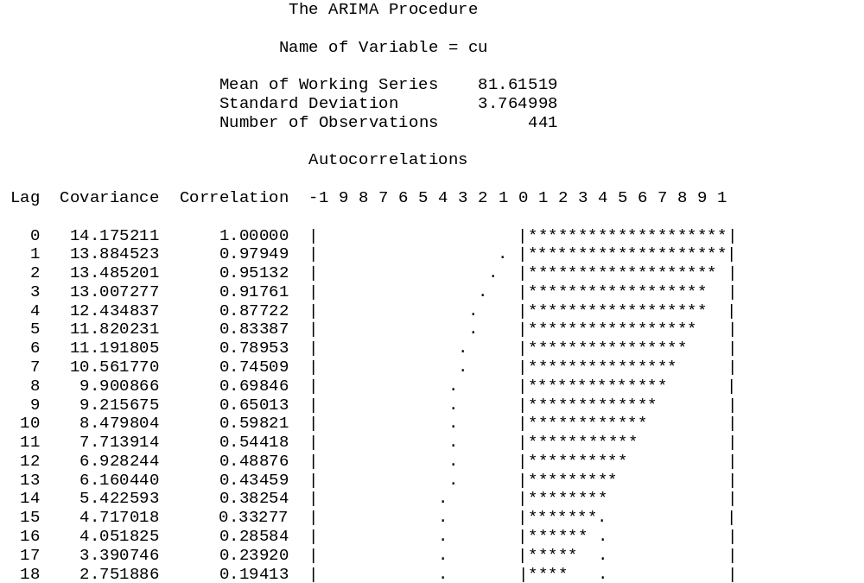
This ACF plot is produced
By SAS using the code:
PROC ARIMA;
IDENTIFY VAR=cu;
It will also produce an
inverse autocorrelation plot
that you can ignore and a
partial autocorrelation plot
that we will use in the
modeling stage.
This plot of the ACF clearly indicates a non-stationary series.
The autocorrelations diminish only very slowly.

Slide 7
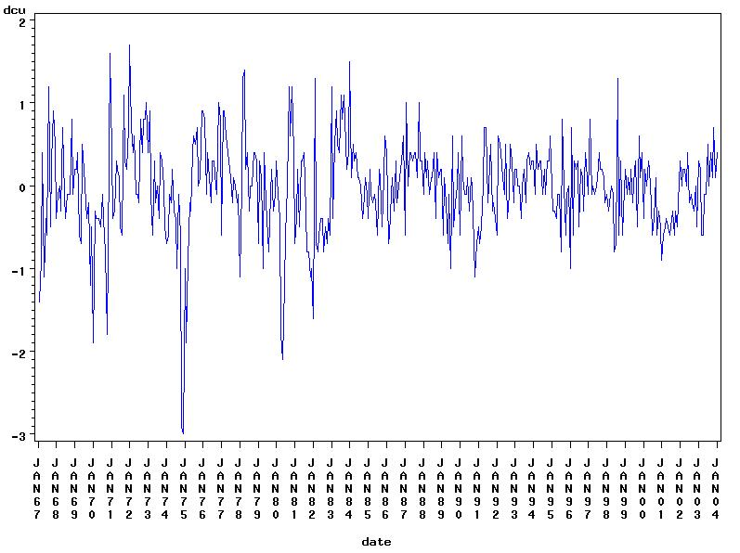
First differences of Capacity Utilization 1967:1 – 2004:03
This graph of first differences appears to be stationary.

Slide 8
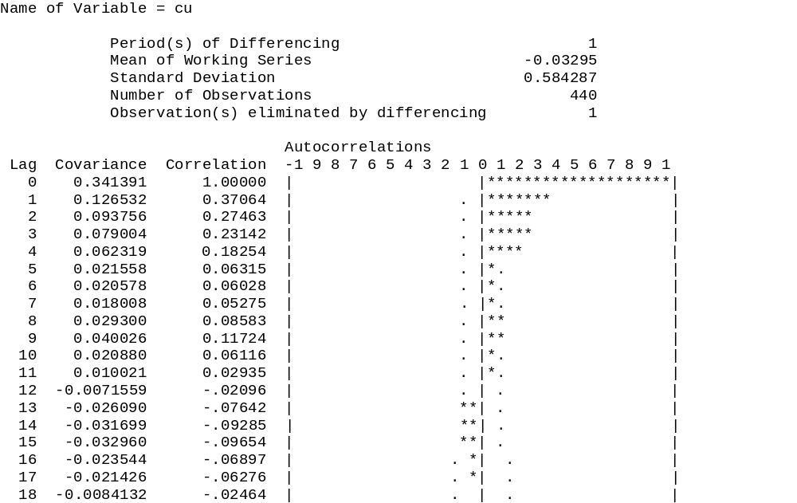
This ACF was produced in SAS
using the code:
PROC ARIMA;
IDENTIFY VAR=cu(1);
RUN;
where the (1) tells SAS to use
first differences.
This ACF shows the autocorrelations diminishing fairly quickly. So we
decide that the first difference of the capacity util. rate is stationary.

Slide 9
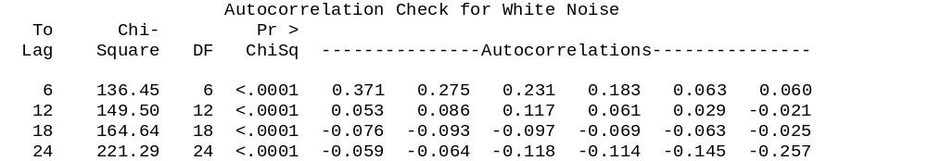
In addition to the autocorrelation function (ACF) and partial autocorrelation
functions (PACF) SAS will print out an autocorrelation check for
white noise. Specifically, it prints out the Ljung-Box statistics, called
Chi-Square below, and the p-values. If the p-value is very small as they are below, then we can reject the null hypothesis that all of the autocorrelations up to the stated lag are jointly zero. For example, for our capacity utilization data (first differences):
H_{o}: ρ₁ =ρ₂ =ρ₃ =ρ₄ =ρ₅ =ρ₆ = 0 (the data series is white noise)
H₁: at least one is non-zero
χ² = 136.45 with a p-value of less than 0.0001 → easily reject Ho
A check for white noise on your stationary series is important, because if your series is white noise there is nothing to model and thus no point in carrying out any estimation or forecasting. We see here that the first difference of capacity utilization is not white noise, so we proceed to the modeling and estimation stage. Note: we can ignore the autocorrelation check for the data before differencing because it is non-stationary.

Slide 10
Model Identification and Estimation:
Examine the Autocorrelation Function (ACF) and Partial Autocorrelation Function (PACF) of your (now) stationary series to get some ideas about what ARIMA(p,d,q) models to estimate. The “d” in ARIMA stands for the number of times the data have been differenced to render to stationary. This was already determined in the previous section.
The “p” in ARIMA(p,d,q) measures the order of the autoregressive component. To get an idea of what orders to consider, examine the partial autocorrelation function. If the time-series has an autoregressive order of 1, called AR(1), then we should see only the first partial autocorrelation coefficient as significant. If it has an AR(2), then we should see only the first and second partial autocorrelation coefficients as significant. (Note, that they could be positive and/or negative; what matters is the statistical significance.) Generally, the partial autocorrelation function PACF will have significant correlations up to lag p, and will quickly drop to near zero values after lag p.

Slide 11
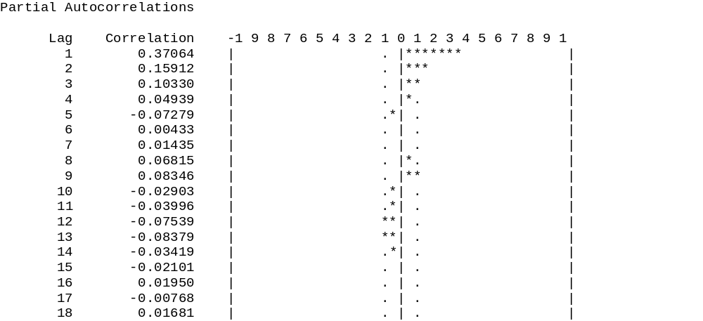
Here is the partial autocorrelation function PACF for the first-differences
capacity utilization series. Notice that the first two (maybe three)
autocorrelations are statistically significant. This suggests AR(2) or AR(3)
model. There is a statistically significant autocorrelation at lag 24 (not printed
here) but this can be ignored. Remember that 5% of the time we can get an
Autocorr. that is more than 2 st. dev.s above zero when in fact the true one is zero.

Slide 12
Model Identification and Estimation: (con’t)
The “q” measures the order of the moving average component. To get an idea of what orders to consider, we examine the autocorrelation function. If the time-series is a moving average of order 1, called a MA(1), we should see only one significant autocorrelation coefficient at lag 1. This is because a MA(1) process has a memory of only one period. If the time-series is a MA(2), we should see only two significant autocorrelation coefficients, at lag 1 and 2, because a MA(2) process has a memory of only two periods. Generally, for a time-series that is a MA(q), the autocorrelation function will have significant correlations up to lag q, and will quickly drop to near zero values after lag q.
For the capacity utilization time-series, we see that the ACF function decays,
but only for the first 4 lags. Then it appears to drop off to zero abruptly. Therefore, a MA(4) might be considered.
Our initial guess is ARIMA(2,1,4) where the 1 tells us that the data have been first-differenced to render it stationary.

Slide 13
Estimate the Models:
To estimate the model in SAS is fairly straight forward. Go back to the PROC ARIMA and add the ESTIMATE command. Here we will estimate four models: ARIMA(1,1,0), ARIMA(1,1,1), ARIMA(2,1,0), and ARIMA(2,1,4). Although we believe the last of these will be the best, it is instructive to estimate a simple AR(1) on our differenced series, this is the ARIMA(1,1,0) a model with an AR(1) and a MA(1) on the differenced series; this is the ARIMA(1,1,1), and a model with only an AR(2) term. This is the ARIMA(2,1,0)
PROC ARIMA;
IDENTIFY VAR=cu(1);
ESTIMATE p = 1:
ESTIMATE p = 1 q=1;
ESTIMATE p = 2;
ESTIMATE p = 2 q = 4;
RUN;
This tells SAS that d=1 for all models
This estimates an ARIMA(1,1,0)
This estimates ARIMA(1,1,1)
This estimates an ARIMA(2,1,0)
This estimates an ARIMA(2,1,4)

Slide 14
Examine the parameter estimates, the AIC statistic and test of white noise for the residuals.
On the next few slides you will see the results of estimating the 4 models discussed in the previous section. We are looking at the statistical significance of the parameter estimates. We also want to compare measures of overall fit. We will use the AIC statistic. It is based on the sum of squared residuals from estimating the model and it balances the reduction in degrees of freedom against the reduction in sum of squared residuals from adding more variables (lags of the time-series). The lower the sum of squared residuals, the better the model. According to Stock and Watson page (455) AIC is,
Where k = p+q+1, the number of
parameters estimated, and n is sample
size the AIC measure will increase.
If ESS decreases, then AIC will decrease.

Slide 15
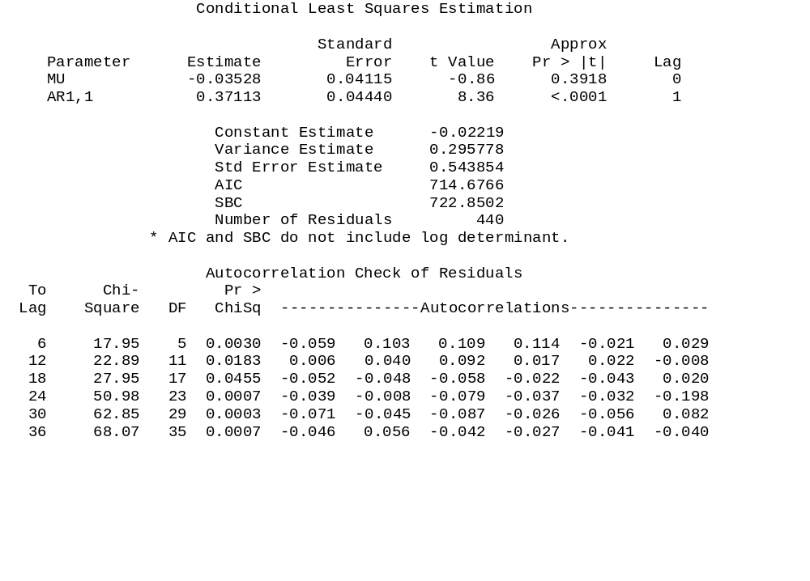
This is the ARIMA(1,1,0) model: Δy_{t} =α₀ +α₁ Δy_{t-1} + u_{t}
These are the
estimates of α₀ and α₁
Things to notice: the parameter estimate on the AR(1) term α₁ is statistically
significant, which is good. However, the autocorrelation check of the residuals tells us that the residuals from this ARIMA(1,1,0) are not white-noise, with a p-value of 0.003. We have left important information in the residuals that could be used. We need a better model.

Slide 16
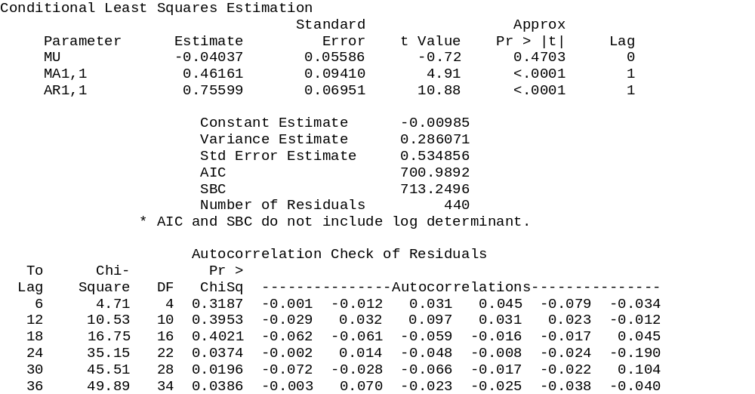
This is the ARIMA(1,1,1) model: Δy_{t} =α₀ +α₁ Δy_{t-1} + u_{t} + β₁u_{t-1}
These are the estimates of
α₀ , α₁ and β₁
Things to notice: the parameter estimates of the AR(1) term α₁ and of the MA(1) term β₁ are statistically significant. Also, the autocorrelation check of the residuals tells us that the residuals from this ARIMA(1,1,1) are white-noise, since the Chi-Square statistics up to a lag of 18 have p-values less than 10%, meaning we cannot reject the null hypothesis that the autocorrelations up to lag 18 are jointly zero (p-value = 0.4021). Also the AIC statistic is smaller. So we might be done …

Slide 17
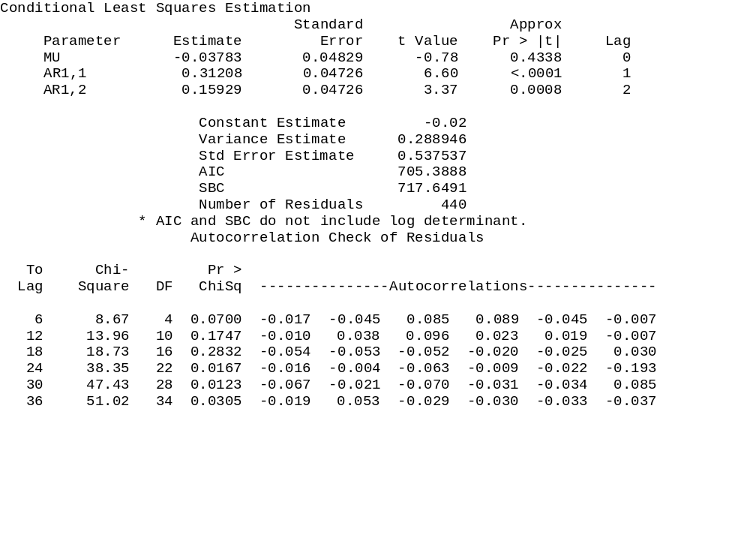
This is the ARIMA(2,1,0) model: Δy_{t} =α₀ +α₁ Δy_{t-1} + α₂ Δy_{t-2} + u_{t}
This model has statistically significant coefficient estimates, the residuals
up to lag 6 reject the null hypothesis of white noise, casting some doubt on this
model. We won’t place much meaning in the Chi-Square statistics for lags
beyond 18. The AIC statistic is larger, which is not good.

Slide 18
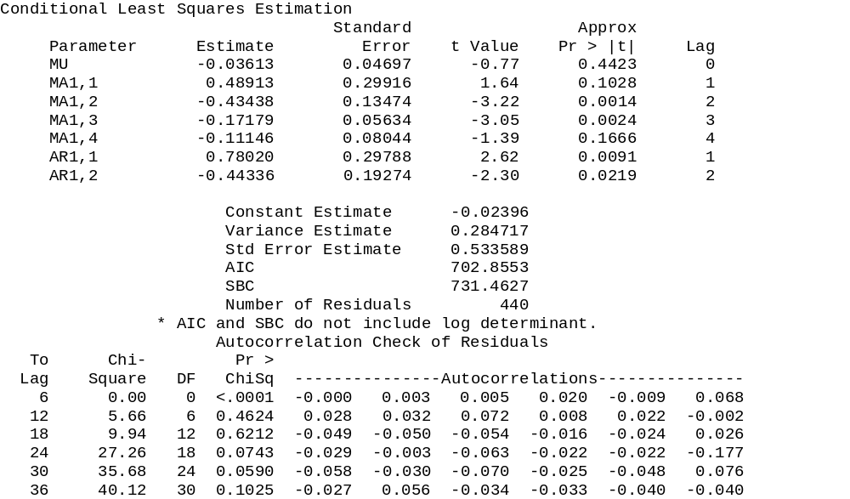
This is the ARIMA(2,1,4) model:
Δy_{t} =α₀ +α₁ Δy_{t-1} +α₂ Δy_{t-2} + u_{t} + β₁u_{t-1} + β₂u_{t-2} + β₃u_{t-3}+ β₄u_{t-4}
Two of the parameter estimates are not statistically significant telling us the model is not “parsimonious”, and the AIC statistic is larger than the AIC for the ARIMA(1,1,1) model. Ignore the first Chi-Square statistic since it has 0 d.o.f. due
to estimating a model with 7 parameters. The Chi-Square statistic at 18 lags is
statistically insignificant indicating white noise.

Slide 19
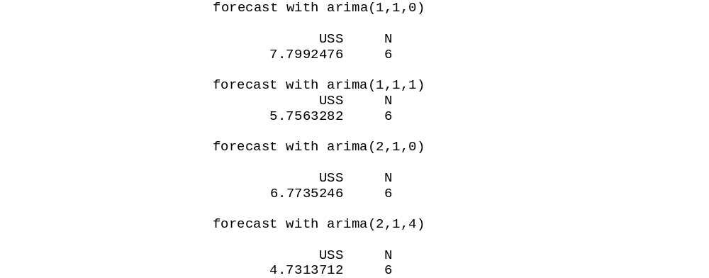
Forecasts:
proc arima;
identify var=cu(1);
estimate p=1; (any model goes here)
forecast lead=6 id=date interval=month out=fore1;
We calculate the Mean Squared Error for the 6 out-of-sample forecasts. Graphs appear on the next four slides. We find that the fourth model produces forecasts with the smallest MSE.
SAS automatically
adjusts the data from
first differences back into
levels.
MSE = (1/6)*Σ(cu^{f} – cuª)²
where f is forecast and
a is actual.

Slide 20
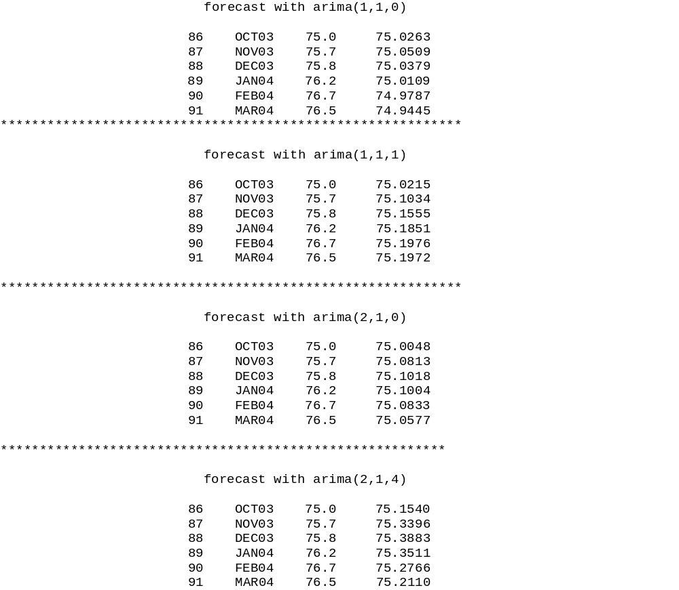
These are the forecasts for
the 4 models. Notice the
model ARIMA(2,1,4)
does the best job as was
confirmed on the previous
slide

Slide 21
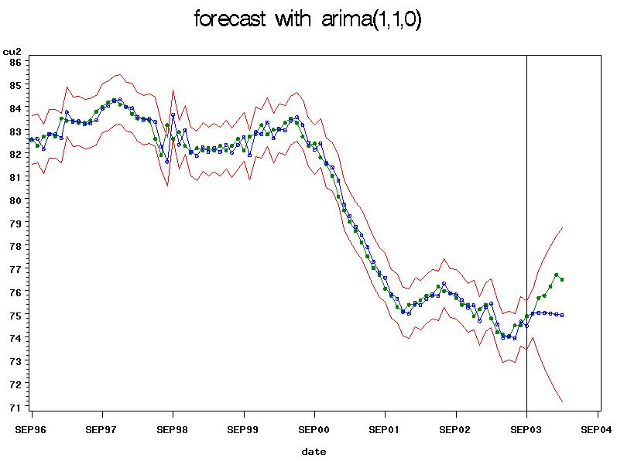

Slide 22
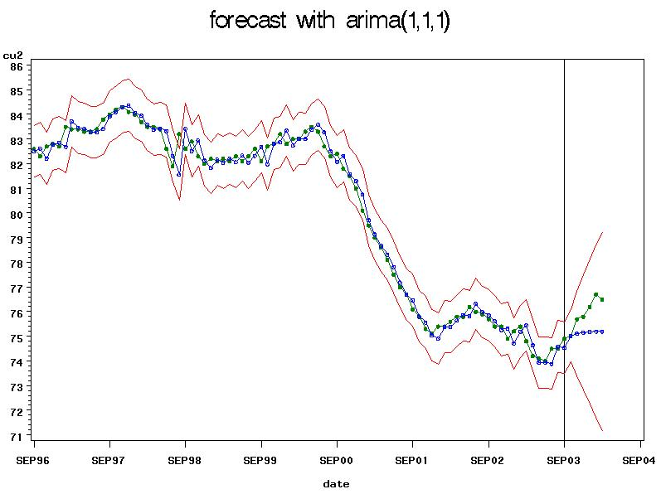

Slide 23
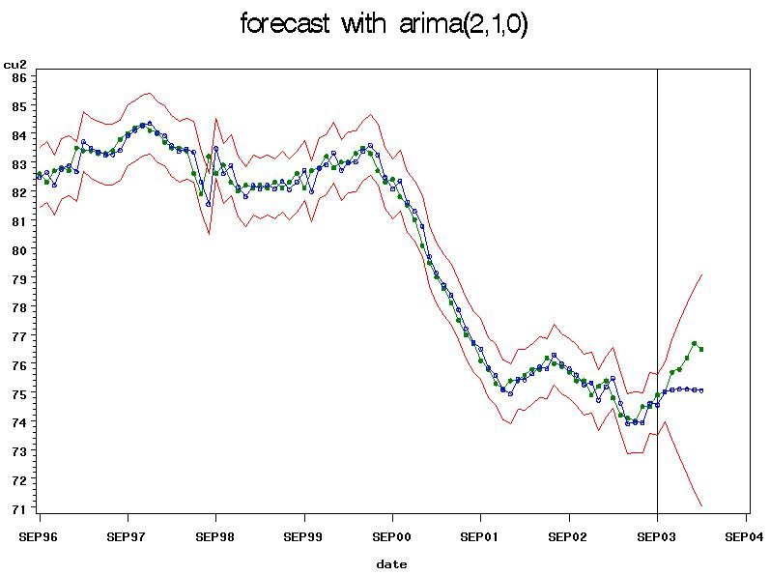

Slide 24
